Slide 1

White Hat
Ethical Hacking
and Information Security

Slide 2
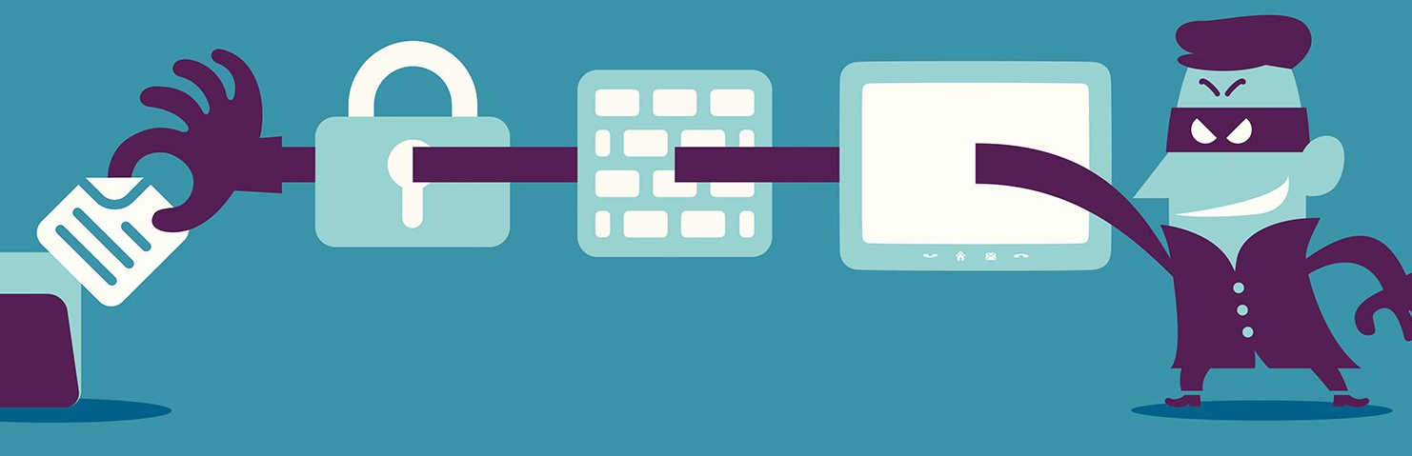
What is Hacking?
Exploiting a system’s vulnerabilities and security controls to gain access to system resources and features outside of the creator’s original purpose.

Slide 3





Script Kiddie | Considered widely as “a class of wannabes” Mostly rely on readymade applications and copies of software.
Green Hat | Aspiring hackers with limited knowledge; Use premade tools and applications, BUT try to understand what they are doing and learn.
White Hat | THE GOOD (ethical) GUYS of the internet; Hold down high paying jobs to thwart the advances of cybercriminals. Act with purpose and within legal bounds and policies laid out for them.
Black Hat | Cyber criminals Often responsible for data breaches, security hacks, malware, virus distribution, Use extensive knowledge of systems to gain illegal access and wreak havoc.
Grey Hat | Not generally criminals, BUT not particularly heartbroken or afraid if they need to hack a system or two, as long as the ends justify means to them.
Our focus!

Slide 4
What is Ethical Hacking?
The use of hacking methods and tools to discover weaknesses for system security.
Ethical hackers are contracted and deployed by the entity being hacked. They always have permission prior to the penetration test.

Slide 5

Parts of a Pen Test
Defining and documenting the scope of test.
Researching the entity.
THE HACK!
Documenting and reporting of ALL results.

Slide 6
The Hack - Breaking it Down
Reconnaissance Phase - Finding the target
Scanning Phase - Identifying systems, mapping out hardware
Gaining Access Phase - Entering via network, OS or application
Maintain Access Phase - PWNing the system
Clearing Tracks Phase - Destroying any proof

Slide 7
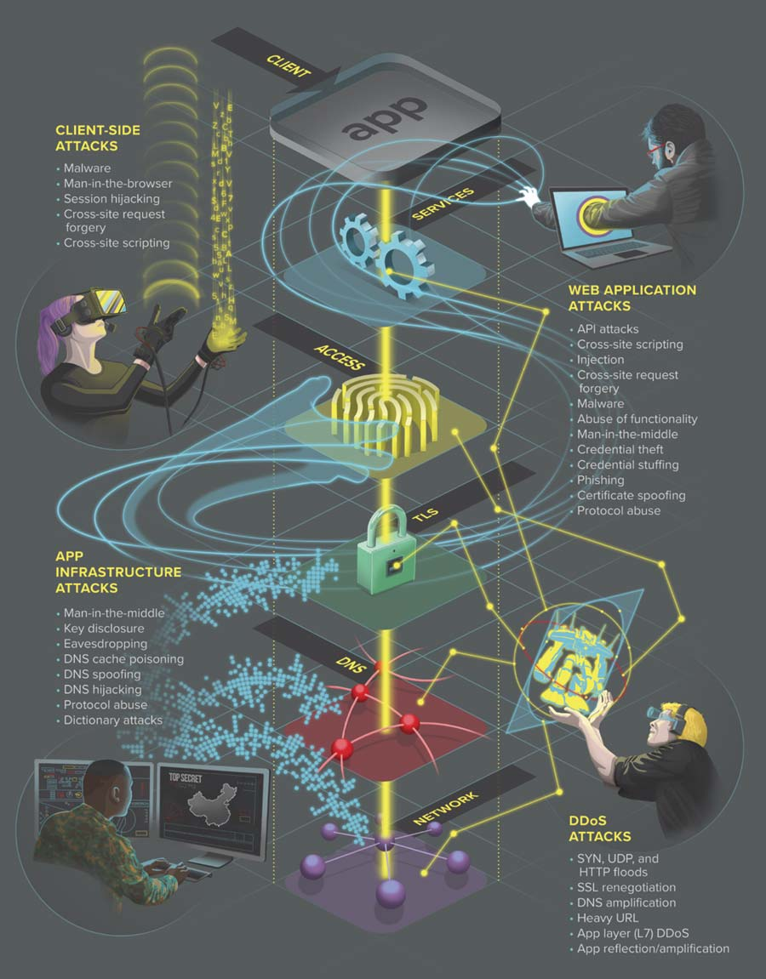


Basic Ethical Hacker Techniques
Password guessing and cracking:
Session hijacking
Session spoofing
Network traffic sniffing
Domain Name System (DNS) Poisoning
Exploiting buffer overflow vulnerabilities
SQL injection
The techniques do consist of qualities that are similar to others; lines are blurred, qualities will seem shared, and lists will not be all inclusive.

Slide 8
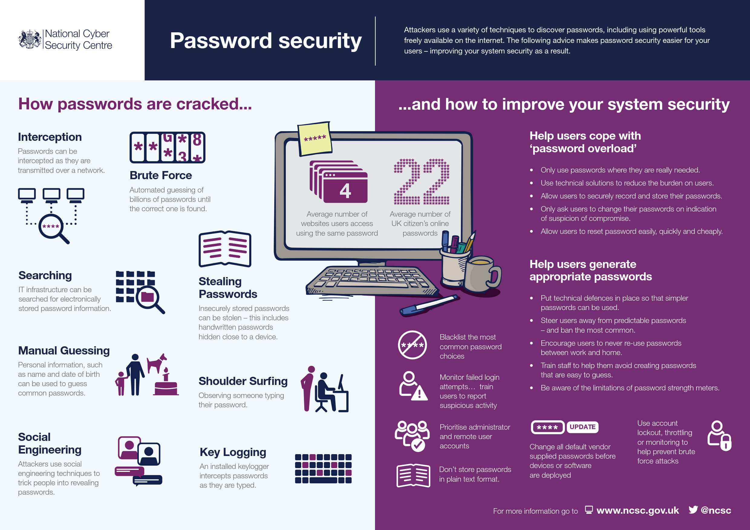
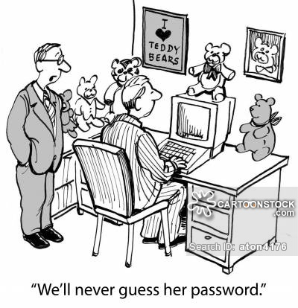
A Closer Look: Password Cracking Technique
Three basic types of password cracking test tools:
Dictionary: file of words run against the accounts
Hybrid: similar to dictionary attack, but adds simple numbers or symbols
Brute force: tries every combination of characters until password is broken

Slide 9

A Closer Look: Network Traffic Sniffing Technique
The process of monitoring and capturing all data packets passing through a given network using sniffing tools.
Data packets are used by diagnostic admin for troubleshooting, BUT hackers use them too.
A packet sniffer is a program that can see all traffic over the network flowing back and forth.
It is also considered a form of “phone tapping” or wiretapping.
What could be sniffed?
Email traffic, passwords, web traffics, router config, chat sessions, DNS (domain name system) traffic
Basically, any data that is passed over the network in clear text is vulnerable to sniffing.
Sniffers are ethically used to help investigate network problems, filter network traffic, and discover misuse, susceptibility, etc
Lawful Interception (LI) is the legally sanctioned official access to private communications, such as emails and phone calls. In generally, LI is the security process in which network operators give law enforcement access to the communications of individuals or organizations. Remember, these things are already being logged...

Slide 10

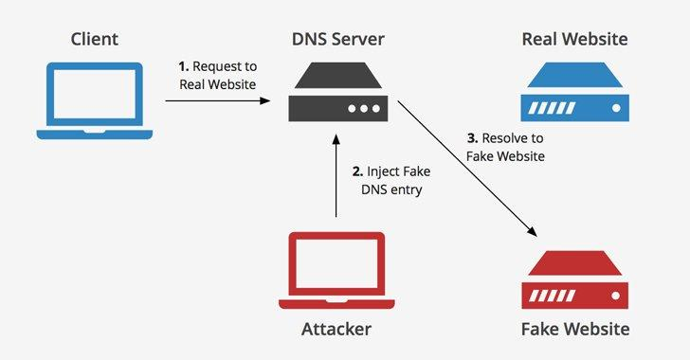
A Closer Look:
Domain Name Server (DNS) Poisoning
A technique that tricks the DNS server into believing that it has received authenticated information, when in reality, it has not.
Primarily used by attackers to redirect users to fake pages usually controlled and managed by the attackers.
Example: If a user intends to go to facebook.com, but has been targeted by DNS poisoning, they may be redirected to another website of malicious content.
In this case, an ethical hacker’s goal is to provide network security to stop all these attacks.
Unlike some of the other techniques, this requires more preventive measures than pen testing. The ethical hacker needs to think about the techniques and practices the attacker may employ and put up obstacles to prevent those practices from being completed.

Slide 11

Ethical Hackers:
Top 10 Tools
Nmap (Network Mapper) - originally a simple scanning utility, now a full pentesting platform
Metasploit - essentially a security framework
Burp Suite - integrated platform for attacking web applications with functionalities like Spider, Proxy, and more.
John the Ripper - popular offline password cracking pentest tool - dictionary attacks
THC Hydra - similar to John the Ripper, but an online tool - dictionary & brute force
OWASP Zed Attack Proxy (ZAP) - integrated pentest tool for find vulnerabilities in web apps
Wireshark - network protocol analyzer tool allowing for live capture and analysis of packages
Aircrack-ng - wireless hacking tool with effectiveness in password hacking
Maltego - digital forensic tool used to deliver a cyber threat picture/graphical layout
Cain and Abel - an ethical password recovery tool for Microsoft Operating systems
Nikto Website Vulnerability Scanner - a web server scanner performs intense tests against servers for multiple items, such as dangerous files, outdated versions, etc.

Slide 12

Social Engineering: The ‘Secret Shoppers’
Secret Shoppers pose as business clients
Third party contracted business
Internal shopper (auditor)
Contact service centers to make sure security protocol is followed.
Secret Shoppers contact banks too:
Common Red Flag Examples of a Fraudster:
International Wires: Esp. China, Russia, Middle East
Recent changes to Personal Information
New bank account on file prior to withdraw request
New Phone number
New Email

Slide 13


The Need for Ethical Hacking
Social Engineering as The CEO
A Fictional Case Study,
Based On A Common Social Engineering ‘Hack’
The scam targets a business that regularly performs wire transfer payments. May be carried out by compromising legitimate business email account or spoofed accounts. Goal is to ‘hack’ or gain access to an CEO or another authority figure’s email.
Once the cybercriminal spoofs or gains access to a company email account and impersonates an executive, they fool an employee into executing unauthorized wire transfers.
Unless the fraud is spotted within 24 hours, the chances of recovery are small.

Slide 14

Interested?
Background/Education Requirements:
A bachelor’s/master’s degree in compSci, information security, or math would provide a strong base.
A military background is also highly recognized by hiring managers.
Skills needed: communication, problem solving, secure tech and organizational skills, impeccable judgement, etc.
Have the ability to think like a black hat, but function within the ethics and legality of the law.
Certifications
Recommended starting point is the Certified Ethical Hacker (CEH) certification from the EC-council.
Will need to have at least 2 years of work experience in the info security domain.
Apply for the exam
Take the exam (125 multiple choice questions for 4 hours) and “pass”.
There is no specific general passing score; it depends on the difficulty of that sessions questions.
FYI: There are also physical aspects of the job
See if you can tailgate through an access gate
Get someone to hold a badge access door open so you bypass security

Slide 15

Professional Development for Hackers
DEFCON
Annual hacking convention in Las Vegas, Nevada
Activities:
“Voting Machine Hacking Village”
“Capture the Flag” (Jeopardy or Attack & Defense)
Recruiters (like the NSA) come to find candidates
CERTIFIED ETHICAL HACKER (CEH)
Demonstrates knowledge of “using the same knowledge and tools as a malicious hacker, but in a lawful and legitimate manner to assess the security posture of a target system.” - Wikipedia

Slide 16


DEMO 1 - DO NOT TRY AT HOME
Spear phishing or whaling:
Domain squat on a similar domain, i.e., zipcodewilrnington.com
Send a targeted email from this domain w/ link to a “spoofed” login portal
For example, Zip Code uses G Suite, so a Google login portal would be ideal
Credentials entered would be POST’d to servlet
Professional tools: GoFish (Go), Kingfisher (Python)
DEMO 2 - TRY IT AT HOME!
OWASP JUICESHOP https://goo.gl/FMF3Ac
an intentionally insecure webapp for security trainings written entirely in JavaScript which encompasses common security flaws.

Slide 17
Sources
“Certified Ethical Hacker.” Wikipedia, Wikimedia Foundation, 24 Nov. 2018, en.wikipedia.org/wiki/Certified_Ethical_Hacker.
Grimes, Roger A. “What Is Ethical Hacking? Penetration Testing Basics and Requirements.” CSO Online, CSO, 24 Jan. 2018,
www.csoonline.com/article/3238128/hacking/what-is-ethical-hacking-penetration-testing-basics.html.
“Hacker Tools: Sniffers.” InfoSec Resources, 21 May 2018, resources.infosecinstitute.com/hacker-tools-sniffers/#gref.
KnowBe4. “CEO Fraud.” KnowBe4, www.knowbe4.com/ceo-fraud.
Meredith, Dale. “Ethical Hacking: Understanding Ethical Hacking.” Sign In - Pluralsight, Pluralsight, 1 Aug. 2018,
app.pluralsight.com/library/courses/ethical-hacking-understanding/table-of-contents.
“Password Cracking Tools and Techniques.” SearchITChannel,
searchitchannel.techtarget.com/feature/Ethical-hacking-tools-and-techniques-Password-cracking.
Tangent, The Dark. “DEF CON Hacking Conference.” DEF CON® 24 Hacking Conference - Speakers, www.defcon.org/.
Tittel, Ed. “How To Become A White Hat Hacker.” Business News Daily, 24 Apr. 2018,
www.businessnewsdaily.com/10713-white-hat-hacker-career.html.
tutorialspoint.com. “Ethical Hacking Sniffing.” Www.tutorialspoint.com, Tutorials Point,
www.tutorialspoint.com/ethical_hacking/ethical_hacking_sniffing.htm.

Slide 18
Clickable Source Links List
https://searchitchannel.techtarget.com/feature/Ethical-hacking-tools-and-techniques-Password-cracking
https://en.wikipedia.org/wiki/Certified_Ethical_Hacker
https://www.defcon.org/
https://www.csoonline.com/article/3238128/hacking/what-is-ethical-hacking-penetration-testing-basics.html
https://app.pluralsight.com/library/courses/ethical-hacking-understanding/table-of-contents
https://app.pluralsight.com/player?course=ethical-hacking-session-hijacking&author=troy-hunt&name=ethical-hacking-session-hijacking-m1&clip=0&mode=live
https://www.knowbe4.com/ceo-fraud
https://www.tutorialspoint.com/ethical_hacking/ethical_hacking_sniffing.htm
https://resources.infosecinstitute.com/hacker-tools-sniffers/#gref
https://resources.infosecinstitute.com/category/certifications-training/ceh/ethical-hacking-tools/
https://www.businessnewsdaily.com/10713-white-hat-hacker-career.html

